Slide 1
The Jack (MA) of all Trade(RS)
Seminar 1 Group 7
Alvin Lim Swee Hung
Deionna Chee Rui Ping
Hor Chia Yee, Lara
Leow Ken Hing Bryan
Timmothy Yonathan

Slide 2
CONTENT OUTLINE
01
02
03
04
05
INTRO TO BUSINESS PROBLEM
BUSINESS
OPPT 1
BUSINESS
OPPT 2
BUSINESS
OPPT 3
CONCLUSION
Deionna Chee
Association Rules
Linear Regression
Quantile Regression
MARS
Time Series
Random Forest
Logistic Regression
MARS

Slide 3
The Business Problem
Increasing Competition Faced by E-Commerce Marketplaces from E-Commerce (Direct-to-Consumer) DTCs
Deionna Chee

Slide 4
MARKETPLACE VS DTC
MARKETPLACE
DTC
Deionna Chee
Platform which offers products and services sold by different brands.
Model where merchants sell their products or services directly to their customers

Slide 5
APPEAL OF DTC MODEL
Flexibility to Expand and Enhance Brand’s Presence
Greater Opportunities to Build Positive Customer Relationships
Increased Margins
Deionna Chee

Slide 6
OUR APPROACH
Deionna Chee
Business Problem 1:
Flexibility to Expand and Enhance Brand’s Presence
Business Opportunity 1:
Cost-Effective Means to Expand and Enhance Seller Presence
Business Problem 2:
Greater Opportunities to Build Positive Customer Relationships
Business Opportunity 2:
Fostering Positive Seller Impressions and Customer Relations
Business Problem 3:
Increased Margins
Business Opportunity 3:
Business Strategy Excellence through Understanding of Customer Lifetime Value (CLV) Trends and Drivers

Slide 7
Our Datasets and
Data Cleaning
Deionna Chee

Slide 8
UCI E-Commerce (DTC) Dataset
Deionna Chee
Data Cleaning Steps
Handling missing/abnormal values.
Removing of rows with missing CustomerIDs.
Assigning average price of product to transactions with Unit Price = 0.
Handling non-purchase transactions.
Filtering them via InvoiceNo and Quantity and removing them afterwards .
Handling cancelled transactions.
Matching them to their corresponding order transaction.
Derived variable
a new ‘Product Variations’ column from StockCode.

Slide 9
Olist E-Commerce (Marketplace) Dataset
Deionna Chee
Data Cleaning Steps
Selecting only transactions that are delivered.
Merging 9 raw data consisting of 9 datasets .
Handling duplicates as a result of data merging (due to reasons such as having multiple review records)
Selecting the most recent review in the final merged data.
Converting time data to the right format
From character to POSIXct object.

Slide 10
OPPORTUNITY 1
Expanding and Enhancing Seller Presence
Deionna Chee

Slide 11
Business Problem 1
Deionna Chee
The DTC model gives brands the flexibility to expand and enhance their presence by controlling all aspects of consumer interactions with the brand

Slide 12
OUR APPROACH
Deionna Chee
Expanding seller presence (increased visibility)
Understanding customers’ purchasing patterns
Building more effective recommendation systems
Enhancing seller presence (increased sales to existing customers)

Slide 13
Association Rules -
Understanding Purchasing Patterns
Deionna Chee
Find meaningful associations and relationships between items in transactions (e.g. which group of items are commonly bought together?)
E-commerce marketplaces’ large transactional databases allow for more effective association rule mining.

Slide 14
Association Rules on Datasets
UCI Dataset
Olist Dataset
Deionna Chee
1 invoiceID → 1 transaction
Association rules between
products (based on ‘stockNo’)
All purchases made by a customer within the same quarter → 1 transaction
Association rules between
products (based on ‘product_id’
sellers (based on ‘seller_id’)

Slide 15
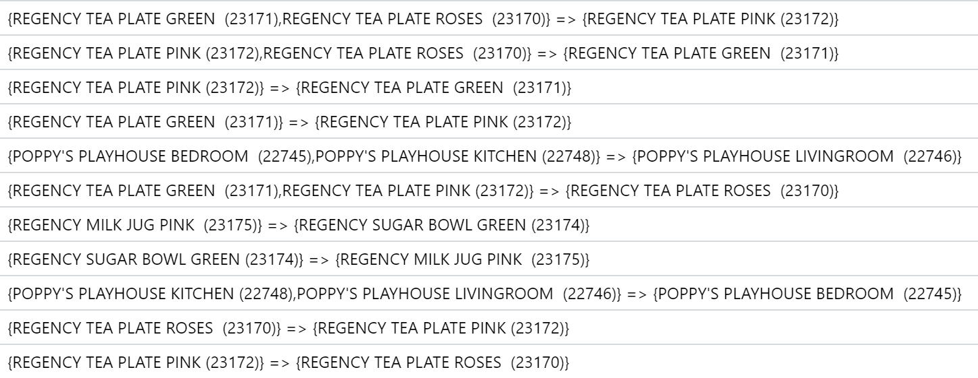
Interesting Insights (UCI Dataset)
Deionna Chee
Different variations of the same products have greater complementary effects.
Top 10 association rules in terms of lift values

Slide 16
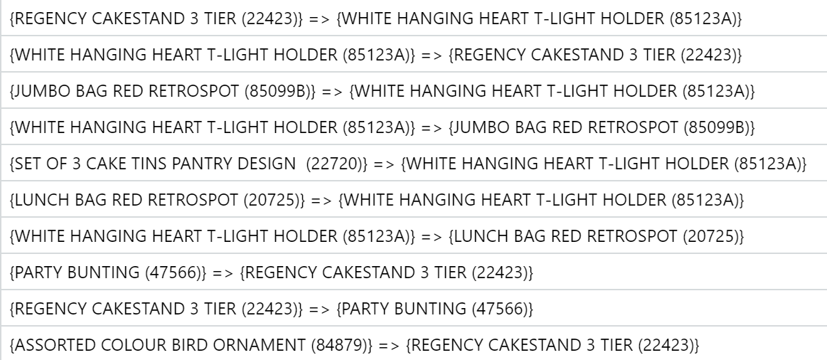
Interesting Insights (UCI Dataset)
Deionna Chee
Different variations of the same products have greater complementary effects.
Bottom 10 association rules in terms of lift values

Slide 17
Interesting Insights (UCI vs Olist)
Deionna Chee
The association rule mining technique was more effective on the UCI dataset as compared to the Olist dataset
Number of association rules derived from the UCI dataset (748) is much greater compared to Olist (28).
This is likely due to a larger number of records in the UCI dataset (394271 rows vs 107823 rows).
Hence, the use of association rules allows marketplaces to gain better understanding of customer purchasing patterns.
Given the advantage of having much more transactional data than DTCs.

Slide 18
Building more effective recommendation systems
Expand Seller Presence
Enhance Seller Presence
Deionna Chee
Recommend complementary products from other sellers when products are added to customers’ carts.
Provide sellers with information on their product complements → increase sales.
Recommend complementary products from the same seller when products are added to customers’ carts

Slide 19
OPPORTUNITY 2
Building Positive Customer Relationships
Lara Hor

Slide 20
Business Problem 2
Lara Hor
The DTC model allows brands to have direct access to their consumers through their own channels, allowing for better customer relationships through connecting with them directly

Slide 21
OUR APPROACH
Lara Hor
Provide sellers with estimated customer ratings
Using machine learning techniques
Sellers improve their customer ratings => improved customer relationships
Suggest improvements based on key variables

Slide 22
Linear Regression
Quantile Regression
MARS
Lara Hor

Slide 23
Predicting Continuous
Review Scores
Lara Hor
Continuous Internal Rating System
Differentiation of Sellers & Products

Slide 24
Calculation of Model Accuracy
Lara Hor
Prediction Score ( x ) | Classified Score
X <= 1.4 | 1
1.4 < x <= 2.4 | 2
2.4 < x <= 3.4 | 3
3.4 < x <= 4.4 | 4
X > 4.4 | 5

Slide 25
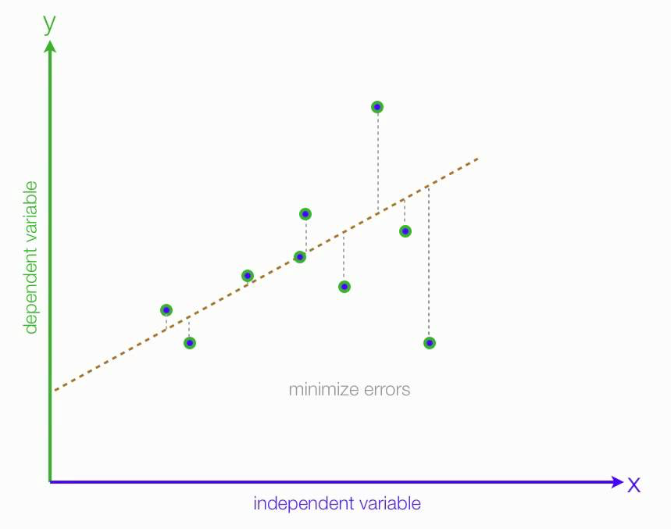
Linear Regression
Lara Hor

Slide 26
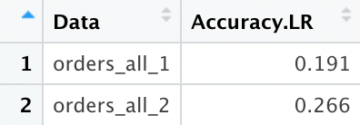
Linear Regression
Lara Hor

Slide 27
Evaluation of Model
Lara Hor
Simple, easier to implement, interpret and train than other models
However, our dataset do not meet the 4 assumptions of linear regression:
Linearity
Homoscedasticity
Independence
Normality

Slide 28
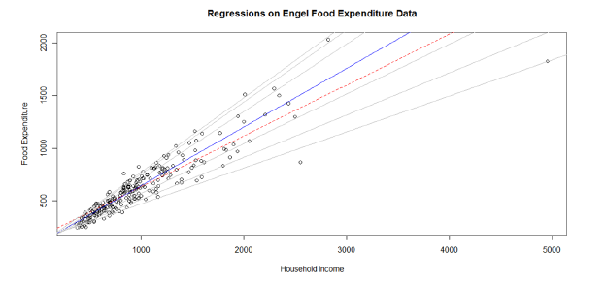
Quantile Regression
Timmothy Yonathan
Quantile regression evaluates the impact of predictor variables on a specific percentile p of the outcome variable Y.

Slide 29
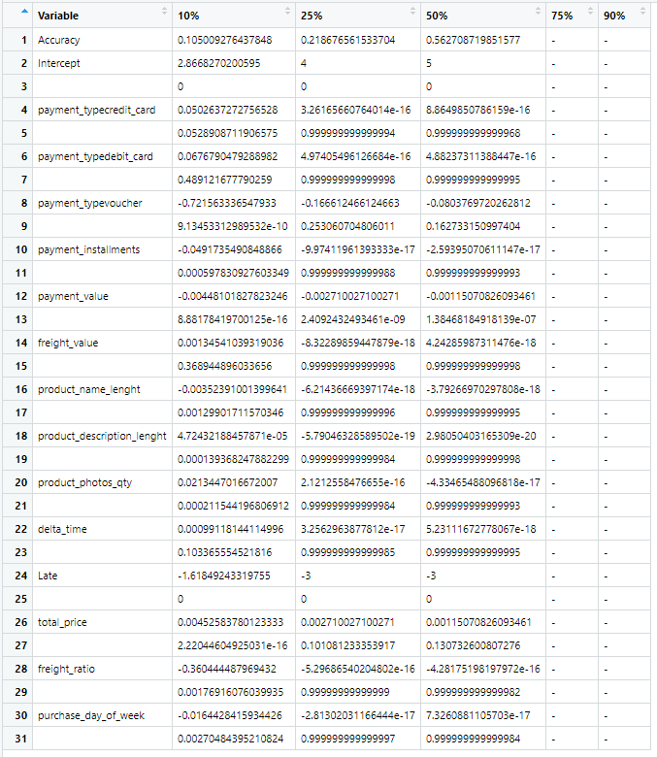
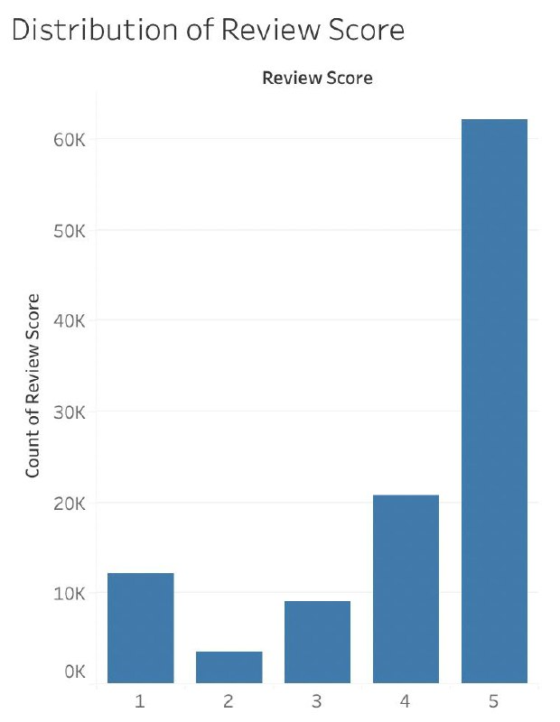
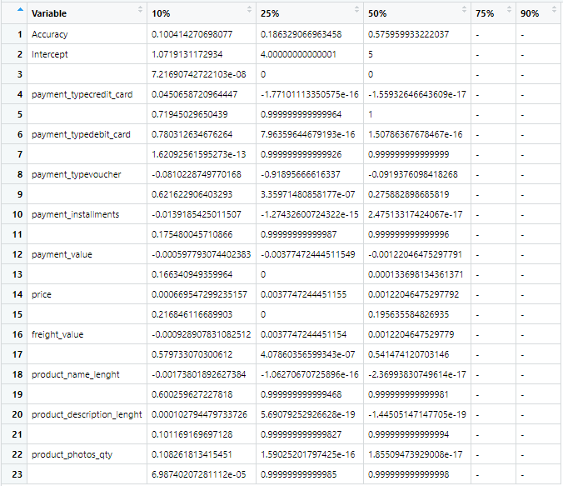
Quantile Regression Findings
Timmothy Yonathan

Slide 30
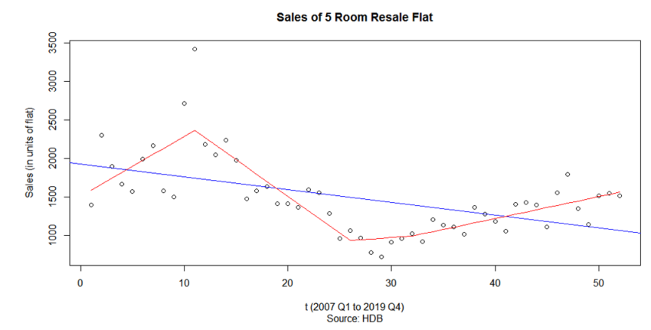
MARS
Timmothy Yonathan
MARS is a form of regression analysis that model nonlinearities between variables

Slide 31
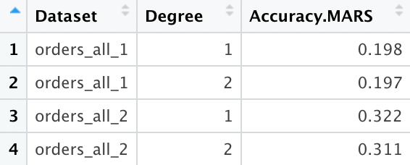
MARS Findings
Timmothy Yonathan

Slide 32
Business Opportunity Conclusion
Accurate Predictions
Generating suggestions
Timmothy Yonathan
MARS
Quantile regression

Slide 33
OPPORTUNITY 3
Understanding Customer Value
Bryan Leow

Slide 34
Business Problem 3
Bryan Leow
The DTC model allows brands to have greater margins by cutting out the platform middlemen, leading to cost savings and hence higher gross margins.

Slide 35
RATIONALE TO GO DTC
Bryan Leow
Gross Margin =
Net Sales – Cost of Goods Sold
Customer Lifetime Value (CLV)
How much each customer spends on average
Customer Acquisition Costs (CAC)
How much it costs to get new customers
Companies cutting out the marketplace platform middlemen:
Can marketplace platforms offer insights to its companies on its CLV performance and how to maximise it?
Revenue
Cost

Slide 36
RATIONALE TO GO DTC
Bryan Leow
CLV =
Average Purchase Value x Average Purchase Frequency
Total Revenue
Total Purchases
No of Purchases
No of Unique Customers

Slide 37
OUR APPROACH
Bryan Leow
Use time-series forecasting techniques
Gain knowledge on how CLV will fare over time
Sellers understand both the how and what of CLV change, informing business strategy
Use machine learning techniques
Determine the key drivers of CLV

Slide 38
Time Series
Random Forest
Logistic Regression
MARS
Bryan Leow

Slide 39
What is Time Series?
Bryan Leow
Successive data points over time
Time series can have trends: average value changes over time
Time series can have seasonality: a pattern repeats in the data
2016
2017
2018

Slide 40
What is Time Series?
Bryan Leow
Successive data points over time
Time series can have trends: average value changes over time
Time series can have seasonality: a pattern repeats in the data
2016
2017
2018

Slide 41
What is Time Series?
Bryan Leow
Successive data points over time
Time series can have trends: average value changes over time
Time series can have seasonality: a pattern repeats in the data
2016
2017
2018

Slide 42
Time Series Forecast Findings
Bryan Leow
Forecast Method: | ¹Error on Shorter Data | ¹Error on Longer Data
Without trend or seasonality | 1.74 | 0.558
With trend, without seasonality | 2.71 | 0.829
With trend, using manual²³ autocorrelation³ ³ | 1.24 | 0.351
With trend, using auto² ² autocorrelation³² | 1.50 | 0.351
¹ Error: scaled with absolute value of CLV. Measured on unseen data (‘testset’)
² Autocorrelation: relation between a present and past value
³ Model: can be configured manually (‘manual’) or automatically (‘auto’) in our
analytics software
Shorter data = UCI (~1 year). Longer data = Olist (~2 years)

Slide 43
Time Series Forecast Findings
Bryan Leow
Forecast Method: | ¹Error on Shorter Data | ¹Error on Longer Data
Without trend or seasonality | 1.74 | 0.558
With trend, without seasonality | 2.71 | 0.829
With trend, using manual² autocorrelation³ | 1.24 | 0.351
With trend, using auto² autocorrelation³ | 1.50 | 0.351
Forecasts on longer data (~2 years, right) gives us more accurate results than shorter data (~1 year, left)

Slide 44
Time Series Forecast Findings
Bryan Leow
Forecast Method: | ¹Error on Shorter Data | ¹Error on Longer Data
Without trend or seasonality | 1.74 | 0.558
With trend, without seasonality | 2.71 | 0.829
With trend, using manual² autocorrelation³ | 1.24 | 0.351
With trend, using auto² autocorrelation³ | 1.50 | 0.351
Forecasts on longer data (~2 years, right) gives us more accurate results than shorter data (~1 year, left)
Forecasts with trend using manual autocorrelation gives the best results

Slide 45
Time Series Forecast Findings
Bryan Leow
Forecast Method: | ¹Error on Shorter Data | ¹Error on Longer Data
Without trend or seasonality | 1.74 | 0.558
With trend, without seasonality | 2.71 | 0.829
With trend, using manual² autocorrelation³ | 1.24 | 0.351
With trend, using auto² autocorrelation³ | 1.50 | 0.351
Forecasts on longer data (~2 years, right) gives us more accurate results than shorter data (~1 year, left)
Forecasts with trend using manual autocorrelation gives the best results
Forecasts with trend and seasonality may be difficult to run as it requires more than 2 years of data. Running on a third dataset shows it performs better than trend without seasonality, but still worse than manual autocorrelation

Slide 46
CLV for…
Bryan Leow
Time Series
Machine Learning
An overall measure for a single time frame (month)
Compare over time frames
Use the formula
A measure tagged to each customer
Compare between customers
Use a slightly different formula based on each customer’s spending habits + clustering

Slide 47
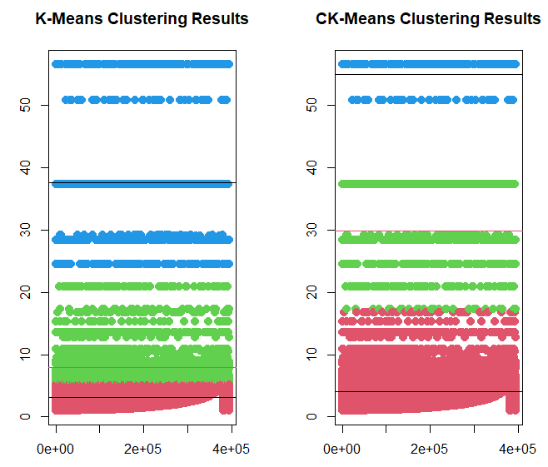
CLV for Machine Learning
Bryan Leow
Clustering of CLV variable
Segregate CLV into “Low”, “Medium” and “High”
Different methods of clustering
Lower error rate

Slide 48
What is Random Forest?
Bryan Leow
What is a Decision Tree?
A series of questions to ask about a row of data. At the end, we will reach a prediction
Is customer from Singapore?
Yes
No
Is it Monday today?
How many products did they buy?
Yes
No
>1
1
Customer has high CLV
Customer has avg CLV
Customer has low CLV
…

Slide 49
What is Random Forest?
Bryan Leow
What is a Forest?
Multiple trees created for one prediction. For classification problems, we take the majority prediction as the answer.

Slide 50
What is Random Forest?
Bryan Leow
What is a Forest?
Why is it called ‘Random’ Forest?
Multiple trees created for one prediction. For classification problems, we take the majority prediction as the answer.
Certain processes go behind the tree creation process to ensure that the trees produced are different from one another.

Slide 51
Random Forest Findings
Bryan Leow
Top 5 Predictors for UCI Dataset:
Top 3 Predictors for UCI Dataset:
Country
Month of Invoice
Day of Week of Invoice
Product Category
Freight Value
Review Score
Customer’s State
Payment Installments
Date of Purchase related variables are not the most important variable in predicting CLV

Slide 52
Random Forest Findings
Bryan Leow
Top 5 Predictors for UCI Dataset:
Top 3 Predictors for UCI Dataset:
Country
Month of Invoice
Day of Week of Invoice
Product Category
Freight Value
Review Score
Customer’s State
Payment Installments
Date of Purchase related variables are not the most important variable in predicting CLV
Cannot easily break down categorical variables, such as Product Category, into their individual categories and their respective performance

Slide 53
Logistic Regression Findings
Alvin
 | Original Trainset | Balanced Trainset
UCI Train | 1: 99.61% 2: 0% 3. 96.78% Overall: 93.92% | 1: 59.07% 2: 63.52% 3. 100% Overall: 74.20%
UCI Test | 1: 99.60% 2: 0% 3: 97.13% Overall: 93.80% | 1: 57.21% 2: 65.34% 3: 100% Overall: 58.52%
Olist Train | 1: 98.39% 2: 40.97% 3: 36.83% Overall: 91.11% | 1: 60.88% 2: 45.99% 3: 71.76% Overall: 59.54%
Olist Test | 1: 98.40% 2: 41.58% 3: 26.70% Overall: 91.34% | 1: 53.00% 2: 37.56% 3: 65.53% Overall: 51.29%

Slide 54
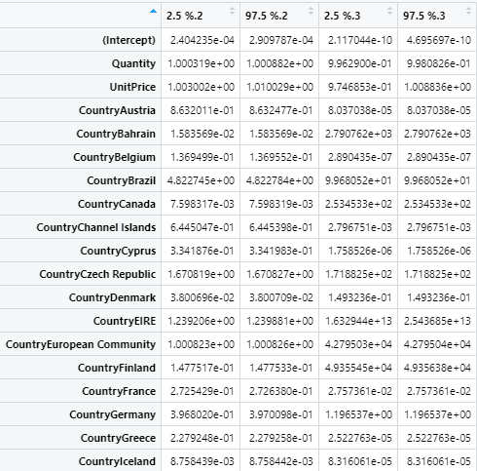
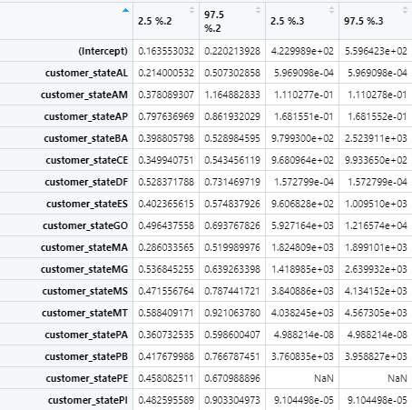
Logistic Regression Findings
Alvin
Alvin

Slide 55
MARS on Categorical Y
glm(list=family(binomial))
A B C
1 0 0
0 1 0
0 0 1
A B C
0.7 0.01 -0.2
-0.5 0.06 0.2
-0.6 0.05 1
Each level is treated as independent of the other levels

Slide 56
MARS Findings
Alvin
 | Original Trainset | Balanced Trainset
UCI Train | 1: 99.48% 2: 5.06% 3. 97.27% Overall: 94.09% | 1: 66.04% 2: 71.40% 3. 100% Overall: 79.15%
UCI Test | 1: 99.49% 2: 5.58% 3: 97.47% Overall: 94.03% | 1: 66.31% 2: 71.64% 3: 100% Overall: 67.28%
Olist Train | 1: 99.56% 2: 6.53% 3: 3.05% Overall: 87.79% | 1: 64.69% 2: 49.05% 3: 81.68% Overall: 65.14%
Olist Test | 1: 99.56% 2: 6.94% 3: 2.43% Overall: 88.18 % | 1: 57.41% 2: 39.29% 3: 65.53% Overall: 55.35%

Slide 57
MARS Findings
Alvin
Dataset | Top 3 Variable Name/Levels
UCI Original Trainset | InvoiceDate_DayofMonth InvoiceDate_MonthName, August Country, United Kingdom
UCI Balanced Trainset | InvoiceDate_MonthName, September InvoiceDate_DayofMonth Country, Finland
Olist Original Trainset | payment_type, voucher product_category_name_english, housewares product_category_name_english, construction_tools_lights
Olist Balanced Trainset | product_category_name_english, watches_gifts product_category_name_english, home_construction product_category_name_english, baby

Slide 58
Business Opportunity Conclusion
Time Series Analysis
Better prediction accuracy for UCI dataset which captures data over a shorter period
Machine Learning Models
Random Forest: High Accuracy but lack definite insights into variable importance
Logistic Regression: High Accuracy but lack conclusive insights into variable importance
MARS: High Accuracy with conclusive variable importance
Conclusive Findings
MARS solves the business problem/opportunity through high accuracy and provision of variable importance breakdown
MARS is the recommended model to use for ecommerce platforms to generate value for its sellers

Slide 59
Overall Conclusion
Alvin
Expand and Enhance Seller Presence → Association Rules
Associative insights across products and sellers
Increase in marginal and overall sales
Ecommerce offers more variety that is unmatched by any DTC
Positive Seller Impressions and Customer Relations → Quantile Regression & MARS
Quantile Regression showed higher accuracy at 50th percentile but had limitations
MARS was brought in to accurately predict customer rates
Ecommerce has a larger customer base, thus able to receive more constructive ratings
Customer Lifetime Value Maximisation → MARS
MARS is able to predict high clv customers with up to 100% accuracy
MARS provided breakdowns into variable importance levels
Ecommerce dataset has better use for machine learning due to accuracy and variable importance
“Ecommerce Platform provides more insights than DTC companies”

Slide 60
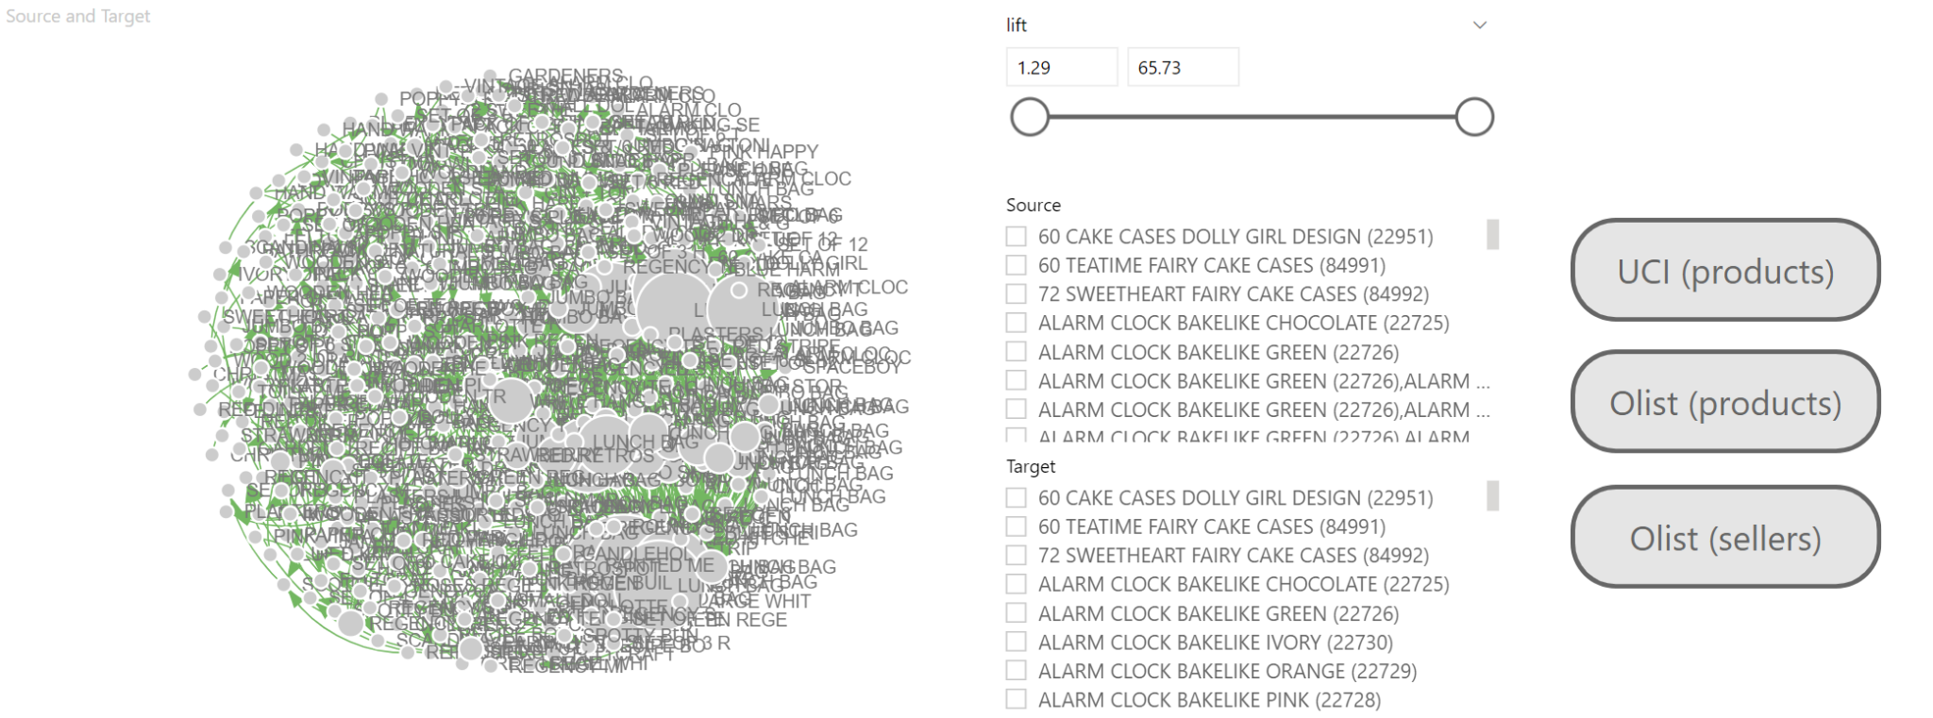
Appendix: Association Rules Dashboard
UCI (products)

Slide 61
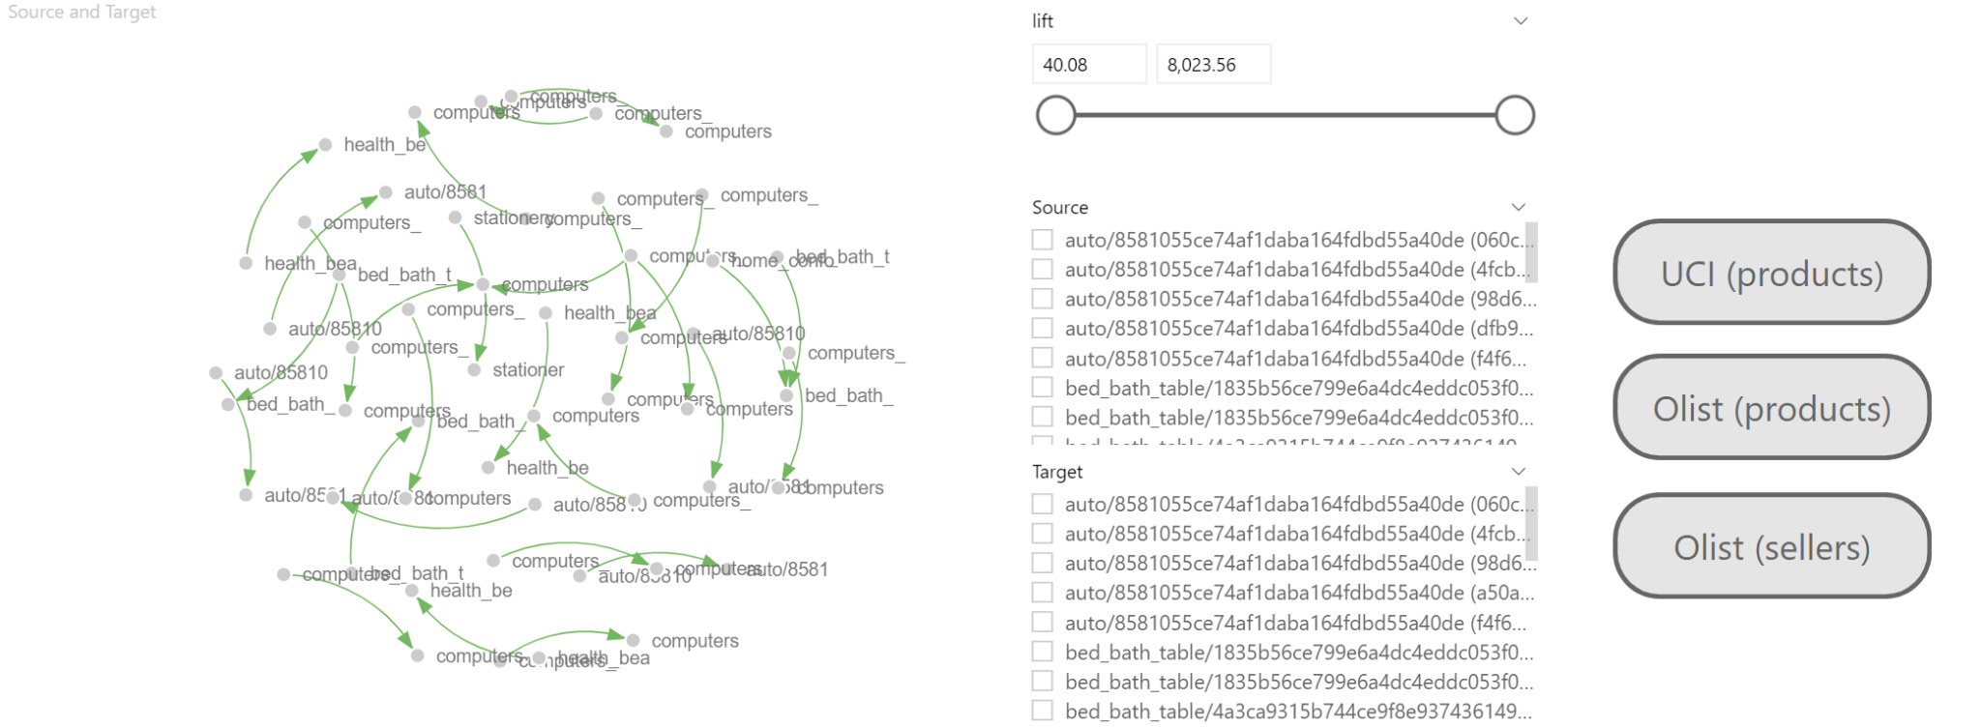
Appendix: Association Rules Dashboard
Olist (products)

Slide 62
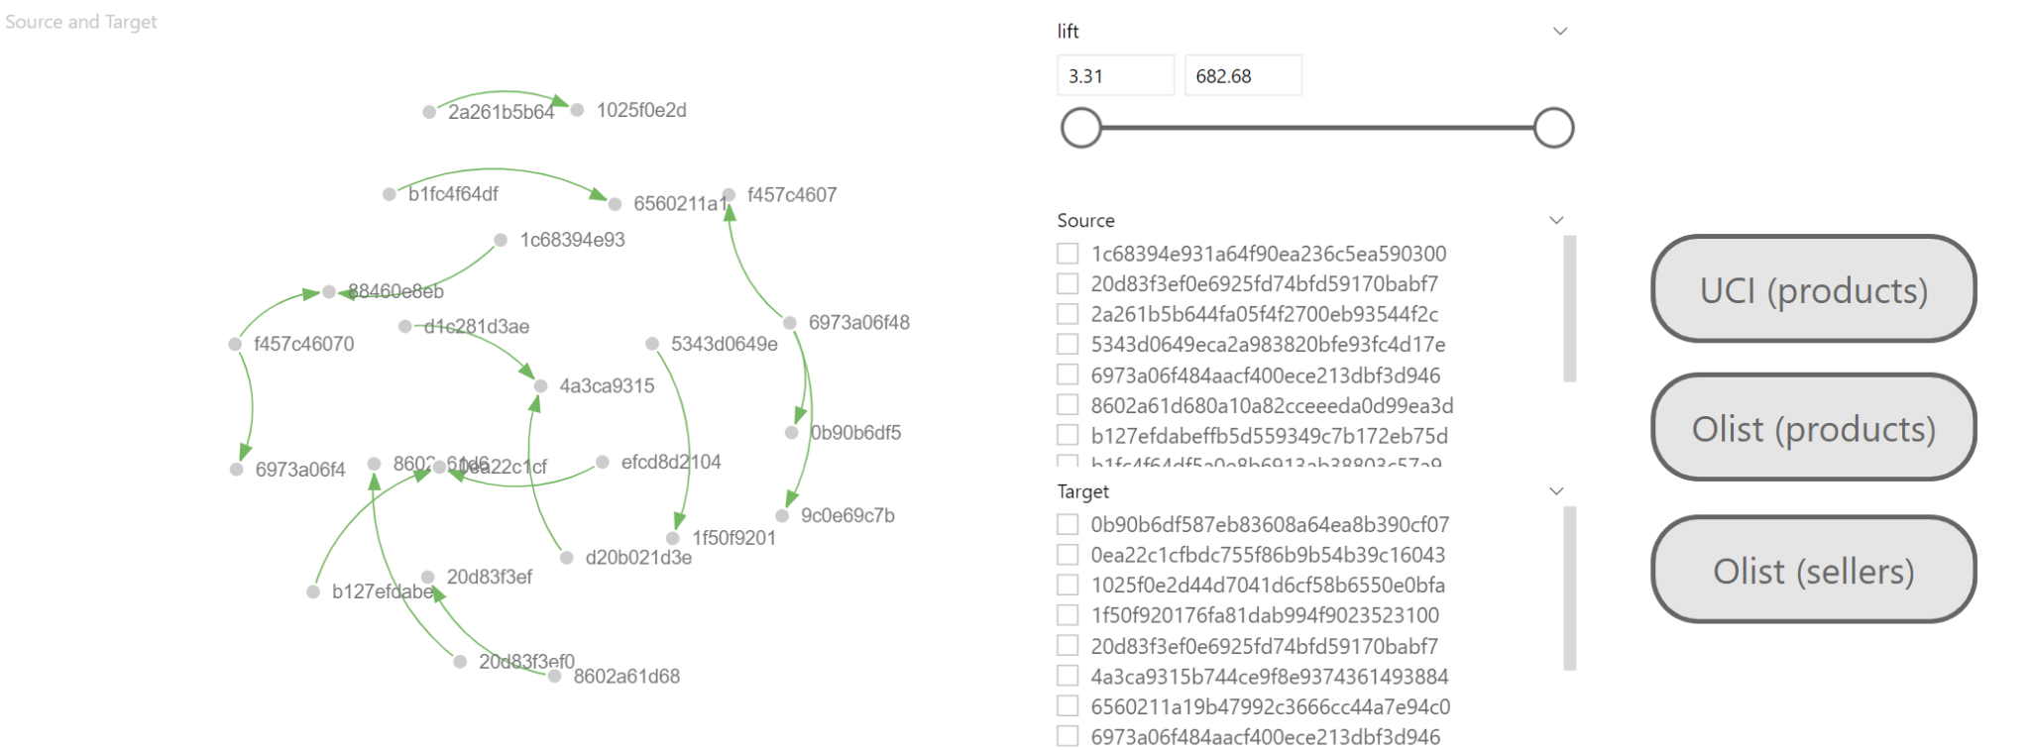
Appendix: Association Rules Dashboard
UCI (products)

Slide 63
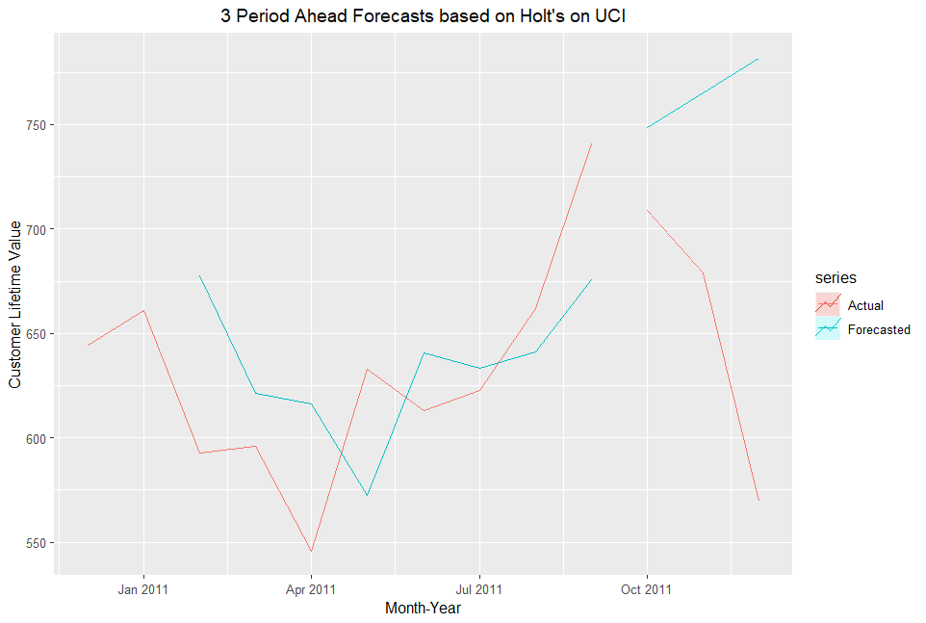
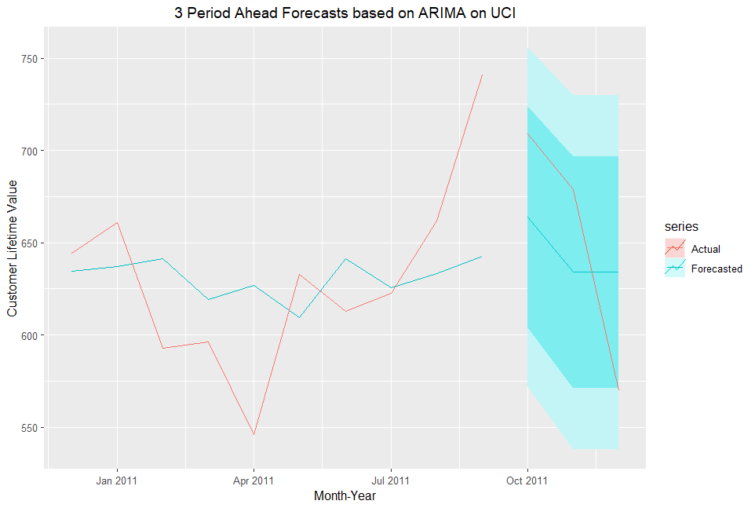
Appendix: Time Series Visualisations

Slide 64
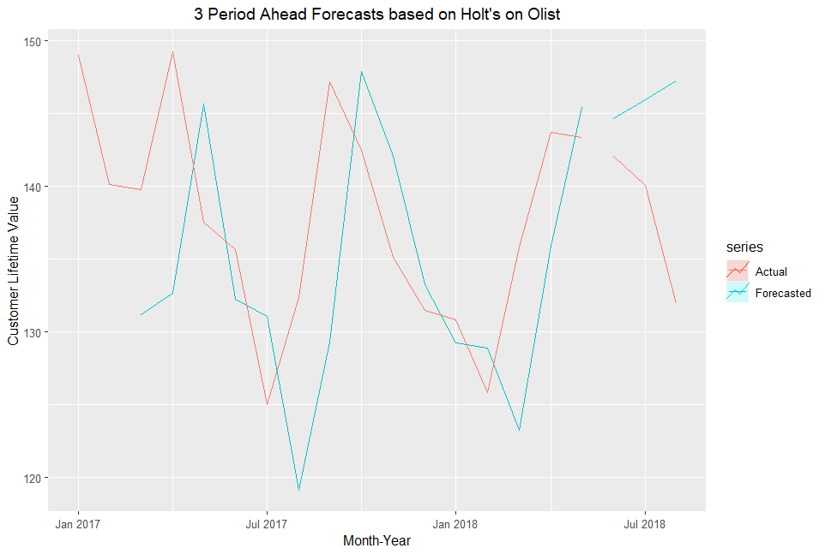
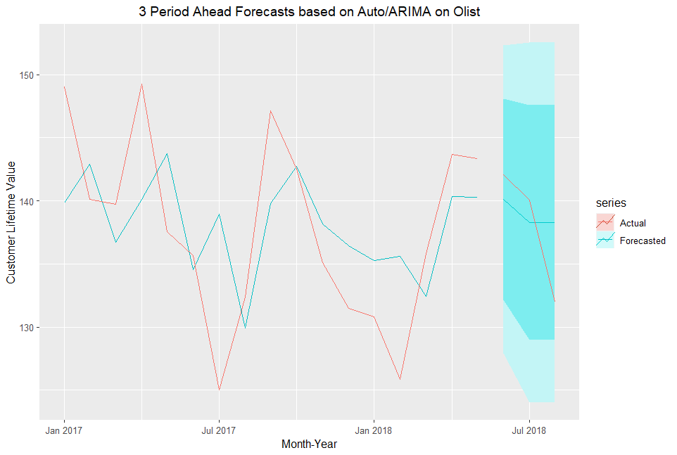
Appendix: Time Series Visualisations

Slide 65
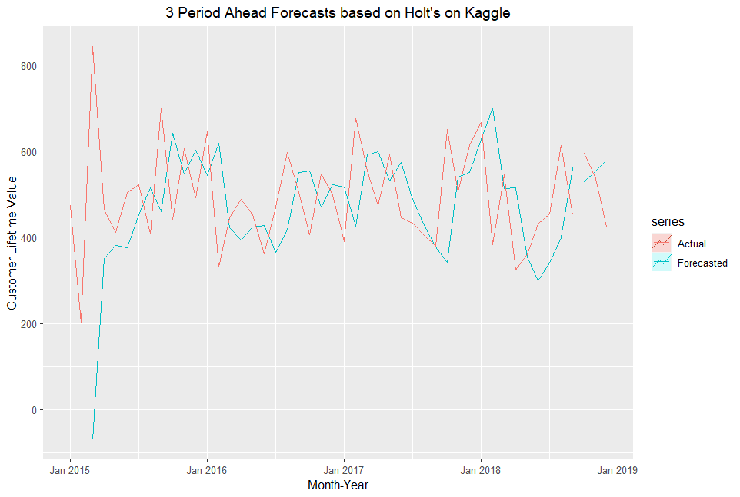
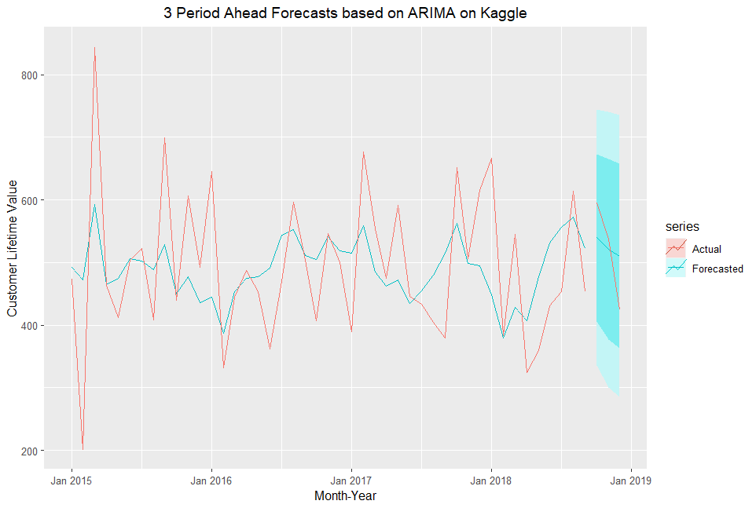
Appendix: Time Series Visualisations

Slide 66
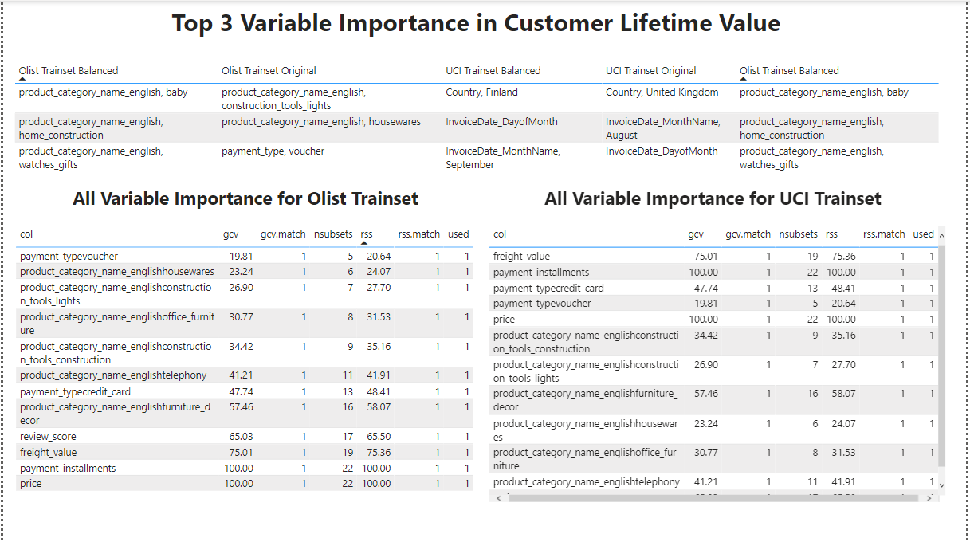
Categorical MARS Dashboard

